Slide 1
Module II
Concurrency Control Techniques

Slide 2
Introduction
Concurrency control protocols
Set of rules to guarantee serializability
Two-phase locking protocols
Lock data items to prevent concurrent access
Timestamp
Unique identifier for each transaction
Multiversion currency control protocols
Use multiple versions of a data item
Validation or certification of a transaction

Slide 3
21.1 Two-Phase Locking Techniques for Concurrency Control
Lock
Variable associated with a data item describing status for operations that can be applied
One lock for each item in the database
Binary locks
Two states (values)
Locked (1)
Item cannot be accessed
Unlocked (0)
Item can be accessed when requested

Slide 4
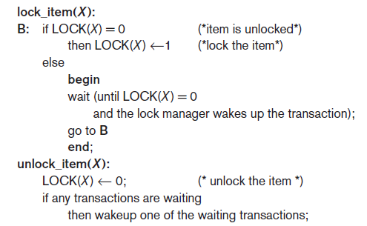
Two-Phase Locking Techniques for Concurrency Control (cont’d.)
Transaction requests access by issuing a lock_item(X) operation
Figure 21.1 Lock and unlock operations for binary locks

Slide 5
Two-Phase Locking Techniques for Concurrency Control (cont’d.)
Lock table specifies items that have locks
Lock manager subsystem
Keeps track of and controls access to locks
Rules enforced by lock manager module
At most one transaction can hold the lock on an item at a given time
Binary locking too restrictive for database items

Slide 6
Two-Phase Locking Techniques for Concurrency Control (cont’d.)
Shared/exclusive or read/write locks
Read operations on the same item are not conflicting
Must have exclusive lock to write
Three locking operations
read_lock(X)
write_lock(X)
unlock(X)

Slide 7
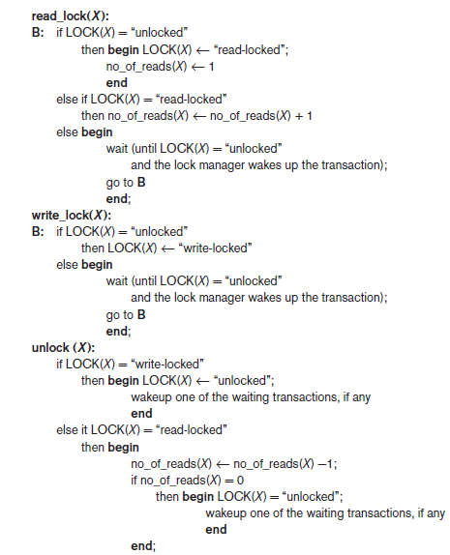
Figure 21.2 Locking and unlocking operations for two-mode (read/write, or shared/exclusive) locks

Slide 8
Two-Phase Locking Techniques for Concurrency Control (cont’d.)
Lock conversion
Transaction that already holds a lock allowed to convert the lock from one state to another
Upgrading
Issue a read_lock operation then a write_lock operation
Downgrading
Issue a read_lock operation after a write_lock operation

Slide 9
Guaranteeing Serializability by Two-Phase Locking
Two-phase locking protocol
All locking operations precede the first unlock operation in the transaction
Phases
Expanding (growing) phase
New locks can be acquired but none can be released
Lock conversion upgrades must be done during this phase
Shrinking phase
Existing locks can be released but none can be acquired
Downgrades must be done during this phase

Slide 10
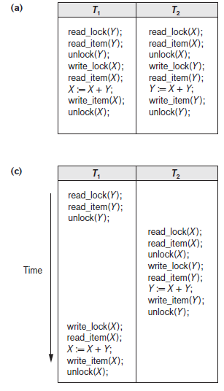
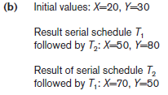
Figure 21.3 Transactions that do not obey two-phase locking (a) Two transactions T1 and T2 (b) Results of possible serial schedules of T1 and T2 (c) A nonserializable schedule S that uses locks

Slide 11
Guaranteeing Serializability by Two-Phase Locking
If every transaction in a schedule follows the two-phase locking protocol, schedule guaranteed to be serializable
Two-phase locking may limit the amount of concurrency that can occur in a schedule
Some serializable schedules will be prohibited by two-phase locking protocol

Slide 12
Variations of Two-Phase Locking
Basic 2PL
Technique described on previous slides
Strict 2PL
Transaction does not release exclusive locks until it commits or aborts
Conservative (static) 2PL
Requires a transaction to lock all the items it accesses before the transaction begins
Predeclare read-set and write-set
Deadlock-free protocol

Slide 13
Variations of Two-Phase Locking (cont’d.)
Rigorous 2PL
Transaction does not release any locks until after it commits or aborts
Concurrency control subsystem responsible for generating read_lock and write_lock requests
Locking generally considered to have high overhead

Slide 14
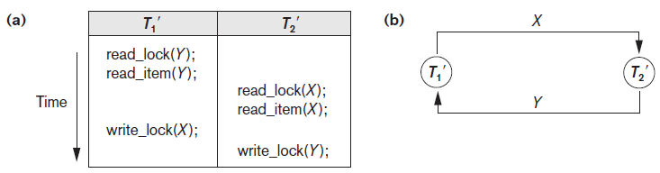
Dealing with Deadlock and Starvation
Deadlock
Occurs when each transaction T in a set is waiting for some item locked by some other transaction T’
Both transactions stuck in a waiting queue
Figure 21.5 Illustrating the deadlock problem (a) A partial schedule of T1′ and T2′ that is
in a state of deadlock (b) A wait-for graph for the partial schedule in (a)

Slide 15
Dealing with Deadlock and Starvation (cont’d.)
Deadlock prevention protocols
Every transaction locks all items it needs in advance
Ordering all items in the database
Transaction that needs several items will lock them in that order
Both approaches impractical
Protocols based on a timestamp
Wait-die
Wound-wait

Slide 16
Dealing with Deadlock and Starvation (cont’d.)
No waiting algorithm
If transaction unable to obtain a lock, immediately aborted and restarted later
Cautious waiting algorithm
Deadlock-free
Deadlock detection
System checks to see if a state of deadlock exists
Wait-for graph

Slide 17
Dealing with Deadlock and Starvation (cont’d.)
Victim selection
Deciding which transaction to abort in case of deadlock
Timeouts
If system waits longer than a predefined time, it aborts the transaction
Starvation
Occurs if a transaction cannot proceed for an indefinite period of time while other transactions continue normally
Solution: first-come-first-served queue

Slide 18
21.2 Concurrency Control Based on Timestamp Ordering
Timestamp
Ordering among the transactions is determined in advance based on their time stamp
The time at which transaction enters into system for execution (i.e. Transaction start time)
Unique identifier assigned by the DBMS to identify a transaction
Assigned in the order submitted
If any transaction T_{j} enters after T_{j}, the relation between time stamp will be TS(T_{j}) <TS(T_{j}) which means that the resulting schedule must be equivalent to a serial schedule T_{j} -> T_{j}

Slide 19
Concurrency Control Based on Timestamp Ordering (cont’d.)
Generating timestamps
Counter incremented each time its value is assigned to a transaction
Current date/time value of the system clock
Ensure no two timestamps are generated during the same tick of the clock
General approach
Enforce equivalent serial order on the transactions based on their timestamps

Slide 20
Concurrency Control Based on Timestamp Ordering (cont’d.)
Concurrency control techniques based on timestamps do not use locks
Deadlocks cannot occur
Timestamp ordering (TO)
Allows interleaving of transaction operations
Must ensure timestamp order is followed for each pair of conflicting operations
Each database item assigned two timestamp values
read_TS(X)
write_TS(X)

Slide 21
Concurrency Control Based on Timestamp Ordering (cont’d.)
Basic TO algorithm
If conflicting operations detected, later operation rejected by aborting transaction that issued it
Schedules produced guaranteed to be conflict serializable
Starvation may occur
Strict TO algorithm
Ensures schedules are both strict and conflict serializable

Slide 22
Concurrency Control Based on Timestamp Ordering (cont’d.)
Thomas’s write rule
Modification of basic TO algorithm
Does not enforce conflict serializability
Rejects fewer write operations by modifying checks for write_item(X) operation
Ignoring outdated writes is called the Thomas write rule
Ex- R1(A)W2(A)W1(A)

Slide 23
21.3 Multiversion Concurrency Control Techniques
Several versions of an item are kept by a system
Some read operations that would be rejected in other techniques can be accepted by reading an older version of the item
Maintains serializability
More storage is needed
Multiversion currency control scheme types
Based on two-phase locking
Based on timestamp ordering
Validation and snapshot isolation techniques

Slide 24
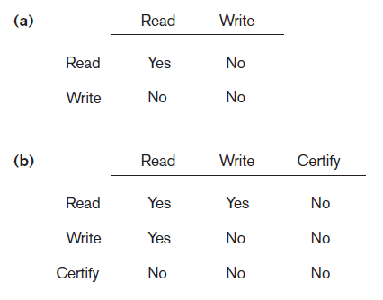
Multiversion Concurrency Control Techniques (cont’d.)
Multiversion two-phase locking using certify locks
Three locking modes: read, write, and certify
Figure 21.6 Lock compatibility tables (a) Lock compatibility table for read/write locking scheme (b) Lock compatibility table for read/write/certify locking scheme

Slide 25
Multiversion Concurrency Control Techniques (cont’d.)
Allow other transaction T2 to read an item X while T1 holds a write lock on X.
Maintain two version of for each item: committed and local version.
Committed version must always be written by some committed transaction.
Local version created when a transaction obtain a write lock on X.
Obtain certify lock before commit.

Slide 26
Multiversion Concurrency Control Techniques (cont’d.)
Several version of data item X such as X1, X2, X3,..,Xk are maintained
Multiversion technique based on timestamp ordering
Two timestamps associated with each version are kept
read_TS(X_{i})-largest of all the timestamps of a transaction that have successfully read version Xi
write_TS(X_{i})- Timestamp of the transaction that wrote the value of version Xi

Slide 27
Ensure serializabilty based on following rules:
If transaction T issues a write_item(X) operation, and version i of X has the highest write_TS(Xi) of all versions of X that is also less than or equal to TS(T), and read_TS(Xi) > TS(T), then abort and roll back transaction T; otherwise, create a new version Xj of X with read_TS(Xj) = write_TS(Xj) = TS(T).
If transaction T issues a read_item(X) operation, find the version i of X that has the highest write_TS(Xi) of all versions of X that is also less than or equal to TS(T); then return the value of Xi to transaction T, and set the value of read_TS(Xi) to the larger of TS(T) and the current read_TS(Xi).
TS(T1) = 4 TS (T2) = 2 TS(T3) = 8 T4 TS(T4)= 6
W(A)
W(A)
W(A)
A1 (10, 2, R.Ts)
A2 (20, 4, R.TS)
A(30, 6, R.TS)
R_4(A2) Allowed
W_4(A3) not allowed. Abort the transaction
W_4(A4) = TS(T4) allowed and a new version is created.

Slide 28
21.4 Validation (Optimistic) Techniques and Snapshot Isolation Concurrency Control
Optimistic techniques
Also called validation or certification techniques
No checking is done while the transaction is executing
Updates not applied directly to the database until finished transaction is validated
All updates applied to local copies of data items
Validation phase checks whether any of transaction’s updates violate serializability
Transaction committed or aborted based on result

Slide 29
Concurrency Control Based on Snapshot Isolation
Transaction sees data items based on committed values of the items in the database snapshot
Does not see updates that occur after transaction starts
Read operations do not require read locks
Write operations require write locks
Temporary version store keeps track of older versions of updated items
Variation: serializable snapshot isolation (SSI)

Slide 30
21.8 Summary
Concurrency control techniques
Two-phase locking
Timestamp-based ordering
Multiversion protocols
Snapshot isolation

